Slide 1
Chapter 12: Subqueries
2023

Slide 2
Chapter 12: Subqueries
Content:
Introduction to subqueries
subquery guidelines
Subquery rules
textual subqueries
CTEs

Slide 3
Attempt the following:
Show all listings that are above avg in price
Show the price and the names of the most expensive listings (for example if the highest listing = R250 000 and there are 3 such listings I want to see all 3. This can vary each day)
Notes:
After they ve attempted these 2 query (each question probably by using 2 different queries) show them how it can be done in 1 subquery
Do not show them the answers before they tried this properly
– see next slide for answers

Slide 4
Show all listings that are above avg in price
Select name from listings
Where price > ( select avg(price) from listings )
Show the price and the names of the most expensive listings (for example if the highest listing = R250 000 and there are 3 such listings I want to see all 3.)
Select name, price from listings
Where price = ( select max(price) from listings )
This inner query will result in 1 answer
This inner query will appear in brackets
Notes:
Select * from listings
where price >= (select avg(price) from listings)
Perhaps do as 2 different queries, and see how they would be combined

Slide 5
Subquery
To accomplish what we need to with 2 queries we can have a subquery in a main query
Select Fname Lname job_title From Job_Current
OUTER QUERY
…
Where job_title in ( );
Select Distinct(title) from Job_Listing
INNER QUERY
Notes:
Let student attempt the following query:
Show all listings that are above avg in price
https://www.universalclass.com/articles/computers/sql/how-to-use-subqueries-in-sql.htm
Subqueries are queries embedded in queries. They are used to retrieve data from one table based on data in another table. They generally are used when tables have some kind of relationship.
With HR data:
What I had to do to move data from HR to HR_unknown / HR_F or HR_M before we were able to do a union again

Slide 6
Subquery
A subquery is a query that is nested inside a SELECT, INSERT , UPDATE or DELETE statement or inside another subquery.
A subquery may occur in :
- A SELECT clause
- A FROM clause
- A WHERE clause
(examples will follow)
You can use the comparison operators such as > < or =. This is used when the inner query results in one answer
Notes:
Many Transact-SQL statements that include subqueries can be alternatively formulated as joins.
Subqueries are used to retrieve data from one table based on data in another table. They generally are used when tables have some kind of relationship.
The subquery (inner query) executes once before the main query (outer query) executes.
The main query (outer query) use the subquery result
Subquery / nested query
Example where used in SELECT → select name, price, ( select max(price) from listings ) HighestPrice from listings;
Example where used in WHERE → Select name, price from listings Where price = ( select max(price) from listings )

Slide 7
A subquery nested in the outer SELECT statement has the following components:
A regular SELECT query including the regular select list components.
A regular FROM clause including one or more table or view names.
An optional WHERE clause.
An optional GROUP BY clause.
An optional HAVING clause.
Notes:
Statements that include a subquery usually take one of these formats:
WHERE expression \[NOT] IN (subquery)
WHERE expression comparison_operator \[ANY | ALL] (subquery)
WHERE \[NOT] EXISTS (subquery)

Slide 8
some guidelines -subqueries
A subquery must be enclosed in → (parentheses)
A subquery must be placed on the right side of the comparison operator.
ORDER BY clause cannot be added into a subquery.
You can use an ORDER BY clause in the main SELECT statement (outer query) which will be the last clause.
If a subquery (inner query) returns a null value to the outer query, the outer query will not return any rows when using certain comparison operators in a WHERE clause.
Notes:
3 - ORDER BY can only be specified when TOP is also specified.

Slide 9
3 different scenarios how we’ll use subqueries:

Slide 10
Select
Select school_name, school_district, passrate, (select max(passrate) from tblResults)
from school_data
School_name | School_district | Passrate | max(passrate)
ROYAL KINGS SCHOOL-MIDRAND | JOHANNESBURG EAST | 97,2 | 98,5
DIEPSLOOT EAST PRIMARY SCHOOL | JOHANNESBURG NORTH | 95 | 98,5
THINKINC ACADEMY | EKURHULENI NORTH | 98,5 | 98,5
OLYMPUS EDUCATIONAL INSTITUTE | JOHANNESBURG EAST | 96,8 | 98,5
THE MUSTARD SEED PRE PRIMARY AND PRIMARY SCHOOL | JOHANNESBURG SOUTH | 92 | 98,5
Notes:
Subquery in SELECT

Slide 11
From
Select country, avg(num_orders) from
(
Select custID, Country, count (*) as num_orders
From orders
Group by 1,2
) as subQ
Group by country
Notes:
Subquery in FROM
Using subqueries is probably the best way to do an aggregate of an aggregate
What is the average number of orders made by country?
In the subquery however, you would first like to establish the nr of orders each customer made

Slide 12
where
Select * from orders
where empID In (Select empID from Employees where surname like ‘van%’)
Notes:
Subquery in WHERE clause
Show the order info from all people who’s surname starts with ‘van’, even though ‘van’ appears on another table

Slide 13
Applicants & PositionsAvailable tables
Two tables about people applying for positions, and actual available positions
Show all details of only the applicants who match any of the positions on the PositionAvailable table
Hint – you can use the “in” function together with a subquery
Notes:
Look at these 2 tables (you wont be able to import them – you can write the queries based on what you see on this slide:
This is details about people applying for positions, and actual available positions:
Show all details of only the applicants who match any of the positions on the PositionAvailable table
Hint – you can use the “in” function together with a subquery
Give them time to try this out
----
Select * from Applicants
Where job_title in ( select title from PositionAvailable )

Slide 14
Select * from Applicants
Where job_title in ( select title from PositionAvailable )
This inner query will result in more than one answer – therefore we use “in”

Slide 15
Find the name of the company that placed order 10290:

Slide 16
SELECT CompanyName
FROM Customers
WHERE CustomerID = (SELECT CustomerID FROM Orders WHERE OrderID = 10290);
Notes:
Find the name of the company that placed order 10290

Slide 17
Subquery: Create table
CREATE TABLE new_table
AS (SELECT * FROM old_table);
CREATE TABLE suppliers
AS (SELECT id, address, city, state, zip FROM companies
WHERE id > 1000);
Notes:
You can also use the SQL CREATE TABLE AS statement to create a table from an existing table by copying the existing table s columns.
2-this would create a new table called suppliers but the new table would only include the specified columns from the companies table.

Slide 18
Subquery– explain only
Notes:
Ask the student to explain what these queries will do – give them time to figure it out

Slide 19
1.
select title, char_length(title)
from books
where char_length(title) = (select max(char_length(title))from books) ;
Notes:
Ask the student to explain what these queries will do – give them time to figure it out
They can write it out line for line or you can ask them to explain the situation of each
1. An alternative way
select title char_length(title)from booksorder by char_length(title) desc
limit 1;
[the problem with this method is that it will only show one book even if there are 3 books with the same amount of characters]
Airbnb – most expensive listing and its name(s)

Slide 20
5.
SELECT * FROM customers
WHERE id IN (SELECT DISTINCT customer_id FROM orders WHERE cost > 200);
6.
SELECT employee_id, first_name, last_name, salary
FROM employees
WHERE salary = (SELECT MAX(salary) FROM employees)
ORDER BY first_name last_name;
7.
SELECT employee_id, first_name, last_name, salary
FROM employees
WHERE salary > (SELECT AVG(salary) FROM employees);
2.
SELECT Name FROM Product
WHERE ProductSubcategoryID IN
(SELECT ProductSubcategoryID FROM ProductSubcategory
WHERE [Name] = Wheels );
3.
SELECT [Name]
FROM Production WHERE ListPrice >
(SELECT AVG (ListPrice) FROM Production);
4.
SELECT * FROM crime_incidents_2014
WHERE Date = (SELECT MIN(date) FROM crime_incidents_2014)

Slide 21
Subquery rules
The select list of a subquery introduced with a comparison operator can include only one expression or column name (except when using Exists / Any / all / some / In).
Because they must return a single value subqueries cannot include GROUP BY and HAVING clauses.
The DISTINCT keyword cannot be used with subqueries that include `GROUP BY.
Notes:
A subquery is subject to the following restrictions:

Slide 22
IN ANY EXISTS SOME or ALL can be used where the inner query results in multiple answers

Slide 23
Subquery: Some / all / exist / any
Subqueries can be composed using the following commands:
SOME- some of data satisfy the query selection
ALL- all of data should satisfy the query selection
EXIST- there exists data that satisfies the query selection
ANY- any of the data satisfies the query selection
Notes:
SOME is an ISO standard equivalent for ANY. (T-SQL)
Some = any = at least one value

Slide 24
exists
The SQL EXISTS Operator
The EXISTS operator is used to test for the existence of any record in a subquery.
The EXISTS operator returns TRUE if the subquery returns one or more records.
Notes:
The EXISTS operator is used to test for the existence of any record in a subquery.
The EXISTS operator returns true if the subquery returns one or more records.
[Show a list of the suppliers who sell products costing less than R20]

Slide 25
exists
SELECT column_name(s) FROM table_name WHERE EXISTS (SELECT column_name FROM table_name WHERE condition);
SELECT SupplierName FROM Suppliers WHERE EXISTS (SELECT ProductName FROM Products
WHERE Products.SupplierID = Suppliers.supplierID AND Price < 20);
Notes:
The EXISTS operator is used to test for the existence of any record in a subquery.
The EXISTS operator returns true if the subquery returns one or more records.
[Show a list of the suppliers who sell products costing less than R20]

Slide 26
any
The SQL ANY Operator
The ANY operator:
returns a Boolean value as a result
returns TRUE if ANY of the subquery values meet the condition
ANY means that the condition will be true if the operation is true for any of the values in the range.
Notes:
The ANY and ALL operators are used with a WHERE or HAVING clause.
The ANY operator returns true if any of the subquery values meet the condition.
1 – [show any productnames where 10 of those products have been ordered]
2 – [show any products that falls in the subcategory – wheels]

Slide 27
any
SELECT column_name(s) FROM table_name WHERE column_name operator ANY (SELECT column_name FROM table_name WHERE condition);
SELECT ProductName FROM Products WHERE ProductID = ANY (SELECT ProductID FROM OrderDetails WHERE Quantity = 10);
SELECT [Name] FROM Product
WHERE ProductSubcategoryID
=ANY (SELECT ProductSubcategoryID FROM ProductSubcategory WHERE Name = Wheels )
Notes:
The ANY and ALL operators are used with a WHERE or HAVING clause.
The ANY operator returns true if any of the subquery values meet the condition.
1 – [show any productnames where 10 of those products have been ordered]
2 – [show any products that falls in the subcategory – wheels]

Slide 28
All
The ALL operator:
returns a Boolean value as a result
returns TRUE if ALL of the subquery values meet the condition
is used with SELECT, WHERE and HAVING statements
ALL means that the condition will be true only if the operation is true for all values in the range.
Notes:
The ALL operator returns true if all of the subquery values meet the condition.
The following SQL statement lists the ProductName if ALL the records in the OrderDetails table has Quantity equal to 10. This will of course return FALSE because the Quantity column has many different values (not only the value of 10):

Slide 29
All
SELECT column_name(s) FROM table_name WHERE column_name operator ALL (SELECT column_name FROM table_name WHERE condition);
SELECT ProductName FROM Products WHERE ProductID = ALL (SELECT ProductID FROM OrderDetails WHERE Quantity = 10);
Notes:
The ALL operator returns true if all of the subquery values meet the condition.
The following SQL statement lists the ProductName if ALL the records in the OrderDetails table has Quantity equal to 10. This will of course return FALSE because the Quantity column has many different values (not only the value of 10):

Slide 30
Subquery
Employee
Country
Dependant
Region
Department
Jobs
Location

Slide 31
Subquery
Display the first and last names, of all the Accountants
Show all employee info of those who works in Finance
How many employees get paid more than the average salary?
Only show the employees who wont be able to earn less than 8,000
L&D
Notes:
L&D com
1. select first_name, last_name from employees$
where job_id = (select job_id from jobs$ where job_title = 'Accountant’)
2. select * from employees$
where department_id = (select department_ID from departments$ where department_name = 'Finance’;
3. select count(employee_id) from employees$
where salary > (select avg(salary) from employees$)
4. select first_name, last_name from employees$
where job_id in (select job_id from jobs$ where min_salary >= 8000)
Use a join to check this:
select e.first_name, e.last_name, j.job_title, e.salary, min_salary from employees$ e
left join Jobs$ j
on j.job_ID = e.job_id
order by min_salary desc;

Slide 32
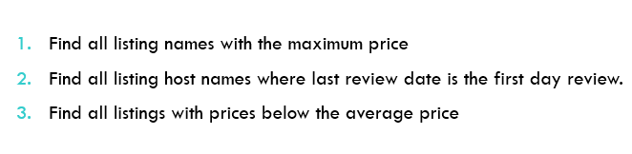
Subquery
AirBnB

Slide 33
CTE (With… as …)
CTE stands for Common Table Expression.
A Named temporary result – it only exist from the moment you run this query until it’s done running. No Temp file exists anywhere. It’s a table being created from which when can then query from.
It’s available temporarily in the execution scope of a statement such as SELECT, INSERT, UPDATE, DELETE, or MERGE.
The syntax: WITH expression_name AS
(CTE_definition)
SQL_statement;
Notes:
Can be used as an alternative to subqueries
CTE is not stored anywhere
You need to include the Select at the bottom together with everything above

Slide 34
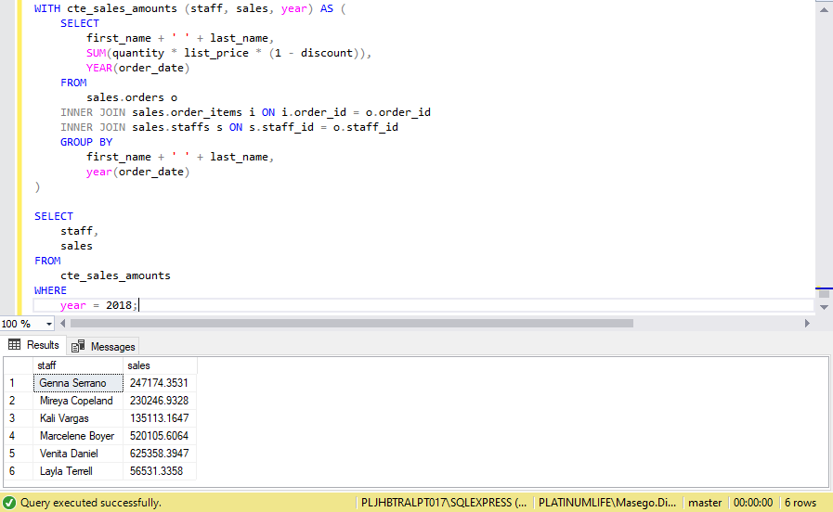
Cte Example
The values in brackets → to rename those 3 columns
The values in brackets → to rename those 3 columns
Notes:
This query uses a CTE to return the sales amounts by sales staffs in 2018:
First, we defined cte_sales_amounts as the name of the common table expression. the CTE returns a result that that consists of three columns staff, year, and sales derived from the definition query.
Second, we constructed a query that returns the total sales amount by sales staff and year by querying data from the orders, order_items and staffs tables.
Third, we referred to the CTE in the outer query and select only the rows whose year are 2018.

Slide 35
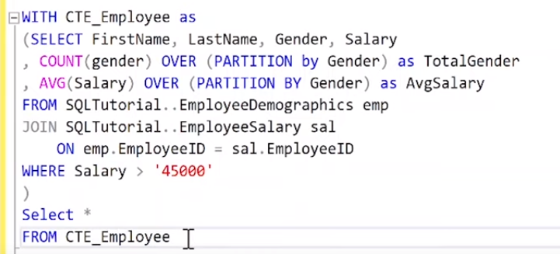
Another example
Notes:
No need to analyse this one
Select Firstname, Lastname, gender, salary, nrOfPeopleOfThatSpecificGender, AvgSalaryforThatSpecificGender

Slide 36

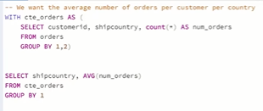
Subquery vs cte(With)

Slide 37
CTE
Employee
Country
Dependant
Region
Department
Jobs
Location

Slide 38
CTE
How many employees work in each department
What is the total amount for Salaries, by Department and by Job Title?
L&D
Notes:
L&D com
With Departmentcount (name, surname, depID, Dep) as
(
Select e.first_name, e.last_name, e.department_id,d.department_name from employees$ e
join departments$ d
on e.department_id=d.department_id
)
select dep, count(*)
from DepartmentCount
Group by dep;
2.
with TotalSal (EmpID, Dep, Job, Salary) as
(
Select e.employee_ID, d.department_name , j.job_title , e.salary
from employees$ e
inner join departments$ d
on e.department_ID = d.department_ID
inner join jobs$ j
on e.job_id = j.job_id
)
Select Dep, Job, sum(Salary)
from TotalSal
group by Dep, Job

